Slide 1
Instructions
Print off the following ten slides and place around the department / school.
Hand out the challenge worksheet to students.
Allow students a few days to go around the school and watch the videos.
Once they have found all ten countries they then go home, do their research and complete the rest of the sheet.
Collect in completed sheets and issue rewards as you see fit.
© WE TEACH MFL

Slide 2
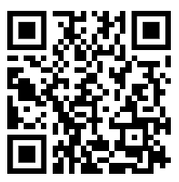
Scan the code, listen to the song and complete your challenge sheet.
Which European country is it from?
How do you say Hello & Goodbye in that language?
Name a famous food or dish from that country.
Name one important historical figure from that country and briefly summarise what they did.
© WE TEACH MFL
Notes:
Spain Blanca Paloma - EAEA
Hello – Hola
Goodbye - Adiós

Slide 3
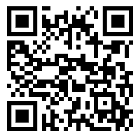
Scan the code, listen to the song and complete your challenge sheet.
Which European country is it from?
How do you say Hello & Goodbye in that language?
Name a famous food or dish from that country.
Name one important historical figure from that country and briefly summarise what they did.
© WE TEACH MFL
Notes:
France La Zarra - Évidemment
Hello – Bonjour
Goodbye – Au revoir

Slide 4
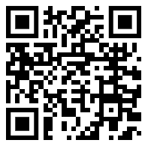
Scan the code, listen to the song and complete your challenge sheet.
Which European country is it from?
How do you say Hello & Goodbye in that language?
Name a famous food or dish from that country.
Name one important historical figure from that country and briefly summarise what they did.
© WE TEACH MFL
Notes:
Italy Marco Mengoni - Due Vite
Hello – Ciao
Goodbye – Arrivederci

Slide 5
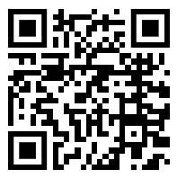
Scan the code, listen to the song and complete your challenge sheet.
Which European country is it from?
How do you say Hello & Goodbye in that language?
Name a famous food or dish from that country.
Name one important historical figure from that country and briefly summarise what they did.
© WE TEACH MFL
Notes:
Finland Käärijä - Cha Cha Cha
Hello – Hei
Goodbye – Hei Hei

Slide 6
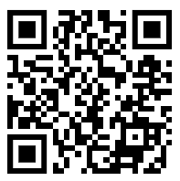
Scan the code, listen to the song and complete your challenge sheet.
Which European country is it from?
How do you say Hello & Goodbye in that language?
Name a famous food or dish from that country.
Name one important historical figure from that country and briefly summarise what they did.
© WE TEACH MFL
Notes:
Germany Lord Of The Lost - Blood & Glitter
Hello – Hallo
Goodbye - Tschüss

Slide 7
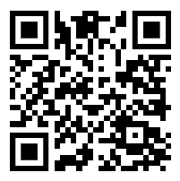
Scan the code, listen to the song and complete your challenge sheet.
Which European country is it from?
How do you say Hello & Goodbye in that language?
Name a famous food or dish from that country.
Name one important historical figure from that country and briefly summarise what they did.
© WE TEACH MFL
Notes:
Croatia Let 3 - Mama ŠČ!
Hello – Zdravo
Goodbye – Pozdrav

Slide 8
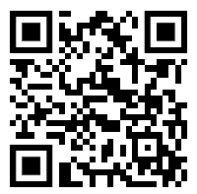
Scan the code, listen to the song and complete your challenge sheet.
Which European country is it from?
How do you say Hello & Goodbye in that language?
Name a famous food or dish from that country.
Name one important historical figure from that country and briefly summarise what they did.
© WE TEACH MFL
Notes:
Portugal Mimicat - Ai Coração
Hello – olá
Goodbye - tchau

Slide 9
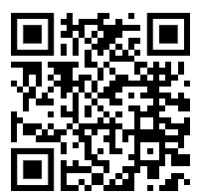
Scan the code, listen to the song and complete your challenge sheet.
Which European country is it from?
How do you say Hello & Goodbye in that language?
Name a famous food or dish from that country.
Name one important historical figure from that country and briefly summarise what they did.
© WE TEACH MFL
Notes:
Ukraine TVORCHI - Heart Of Steel
Hello – Zdravstvuyte / дравствуйте
Goodbye - do pobachennya / до побачення

Slide 10
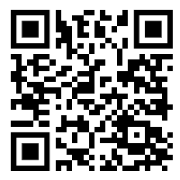
Scan the code, listen to the song and complete your challenge sheet.
Which European country is it from?
How do you say Hello & Goodbye in that language?
Name a famous food or dish from that country.
Name one important historical figure from that country and briefly summarise what they did.
© WE TEACH MFL
Notes:
Slovenia Joker Out - Carpe Diem
Hello – zdravo
Goodbye - Adijo

Slide 11
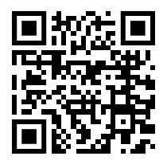
Scan the code, listen to the song and complete your challenge sheet.
Which European country is it from?
How do you say Hello & Goodbye in that language?
Name a famous food or dish from that country.
Name one important historical figure from that country and briefly summarise what they did.
© WE TEACH MFL
Notes:
Iceland Diljá - Power
Hello – Halló
Goodbye - bless

Slide 12
Eurovision Challenge
Song | Country | How do you say ‘hello’? | How do you say ‘goodbye’? | Famous food/dish | Historical figure | What did they do?
1
2
3
4
5
6
7
8
9
10
© WE TEACH MFL
Notes:
Student Handout

