Slide 1
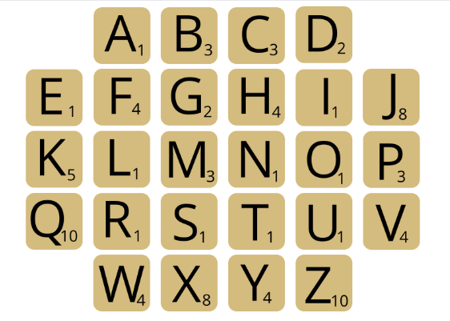
Are you the top scorer for our Scrabble challenge?
Think of a word related to the topic of holidays. Spell it out and add up your points. The student with the highest score wins.
For example:
P+L+A+G+E
3+1+1+2+1
Scrabble score = 8
© We Teach MFL

