Slide 1
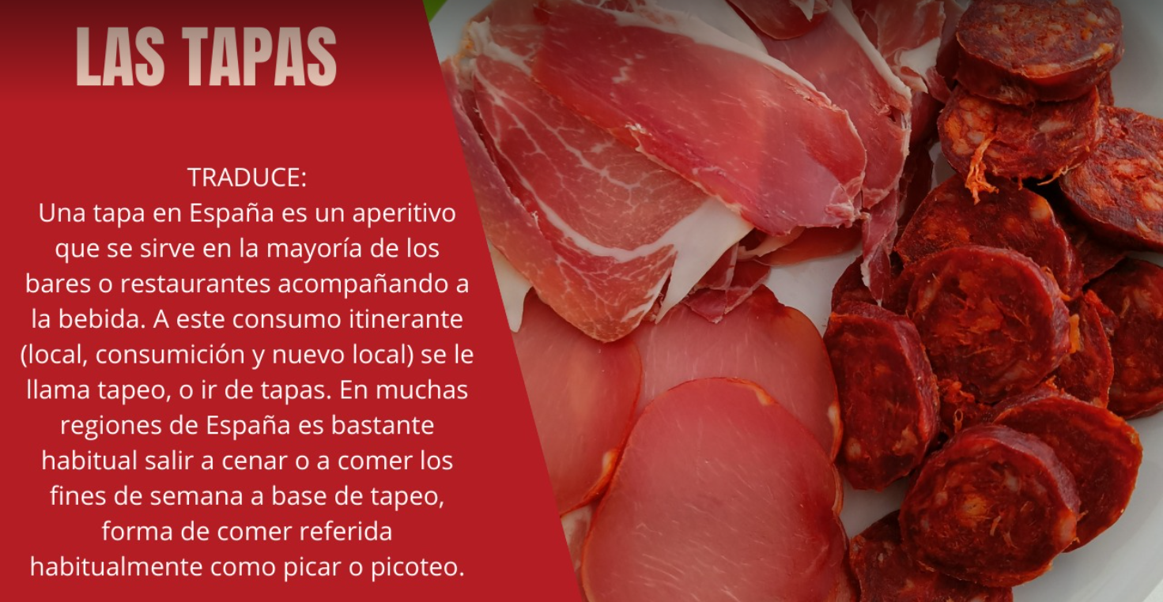
© WE TEACH MFL

Slide 2
© WE TEACH MFL

Slide 3
© WE TEACH MFL

Slide 4
© WE TEACH MFL

Slide 5
© WE TEACH MFL

