Slide 1
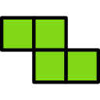
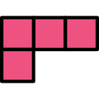
Topic
1
2.
3
4.
5.
6.
Tetris Translations
Roll the dice. This will give you the shape.
Roll the dice again. You have to translate the sentence to drop the shape. If you are incorrect your partner can drop the shape.
Each shape can be rotated to drop in any way but CANNOT be placed underneath.
Complete a row to earn a point. The most points by the end of the game wins.
The game ends when a shape touches the top bar.
Topic
1
2.
3
4.
5.
6.
Topic
1
2.
3
4.
5.
6.
Topic
1
2.
3
4.
5.
6.
Topic
1
2.
3
4.
5.
6.
Topic
1
2.
3
4.
5.
6.
Topic
1
2.
3
4.
5.
6.
Topic
1
2.
3
4.
5.
6.
Topic
1
2.
3
4.
5.
6.
Topic
1
2.
3
4.
5.
6.
Topic
1
2.
3
4.
5.
6.
Topic
1
2.
3
4.
5.
6.
© We Teach MFL

